Slide 1
Unscented Kalman Filtering for Simultaneous Estimation of Attitude and Gyroscope Bias
Donghoon Kang^{1,2}, Cheongjae Jang¹, and Frank C. Park¹
¹Seoul National University
²Korea Institute of Science and Technology

Slide 2
Agenda
Motivation
Preliminaries
Proposed Algorithm
Experimental Results
Demos

Slide 3
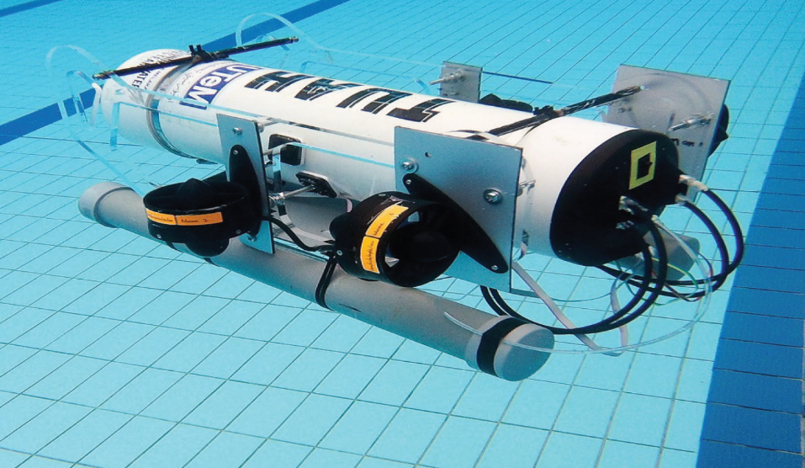
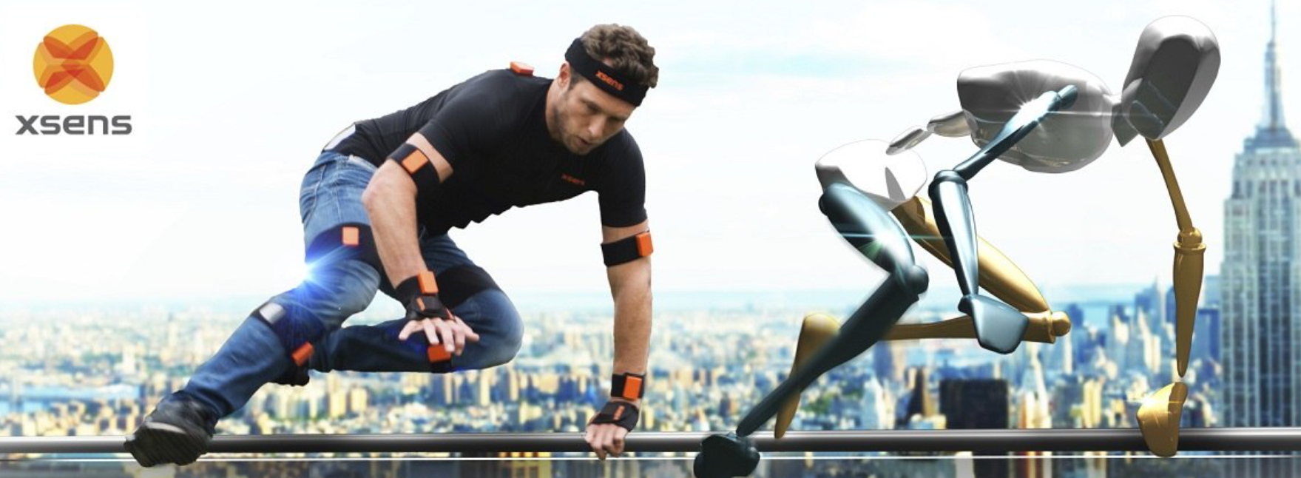
Applications:
Estimation of Attitude using an IMU (Inertial Measurement Unit)
Autonomous Vehicles
Motion Capture

Slide 4
Estimation of Attitude and Gyro Bias
Deterministic Methods: Faster, Sub-optimal
e.g., Nonlinear filters
Does not consider the characteristics of sensor noises.
Stochastic Methods: Slower, Optimal
e.g., EKF, UKF, Particle filters
Consider the noise characteristics

Slide 5
Filtering on Vector Spaces
EKF (Extended Kalman Filter)
Require Jacobian Matrices
Perform a linearization at an estimated state
Sigma points
UKF (Unscented Kalman Filter)
Do not require Jacobian Matrices
Perform a LINEAR weighted regression using “sigma points”.
Covariance
Caution :
Attitude (or unit vector) does NOT construct a linear vector space, but a curved space

Slide 6
Motivation
Existing methods have not fully considered constraints on sigma points
- e.g., a unit-norm constraint on sigma points
state sigma points: a unit quaternion or
observation sigma points: a concatenated vector of unit vectors
Inaccurate Covariance

Slide 7


In our method,
Sigma points for the state :
$$SO\left(3\right)×ℝ^{3}$$
Sigma points for the observation :
$$SO\left(3\right)$$
(reconstructed from Wahba’s problem)
We consider constraints on sigma points.

Slide 8
Main Contributions
Proposing the state dynamics and measurements in a way that leads to “closed-form” equations for covariance propagation and update in a matrix Lie group setting.
Presenting an alternative form of the covariance of the solution to Wahba’s Problem, which is more efficient and accurate.

Slide 9
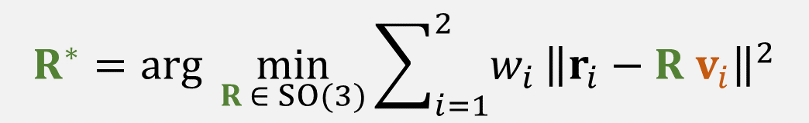
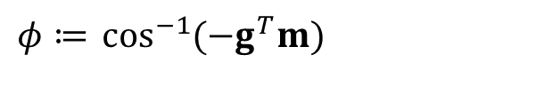


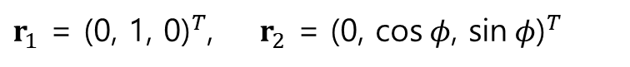
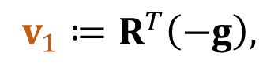
Preliminaries (1)
unknown attitude matrix
$$ω^{m} = ω + b + η_{g}$$
Gyro
measurement
truth
bias
noise
Let us define
$φ≔$ $\cos^{−1}{(−g^{T}m) }$
We can set reference vectors:
$r_{1}$ = ${\text{(0, 1, 0)}}^{T}$, ${ r}_{2}$ = ${\text{(0, }\text{cos} φ\text{, }\text{sin} φ\text{)}}^{T}$
Wahba’s Problem
$$R^{∗}=arg\min_{R ∈ SO(3)}{\sum_{i=1}^{2}{w_{i}}}{\left\|r_{i}−R v_{i}\right\|}^{2}$$
where
$$v_{1}≔R^{T}\left(−g\right),$$
$$v_{2}≔R^{T}m$$

Slide 10
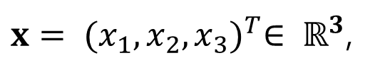
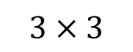
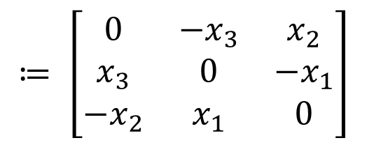
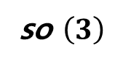
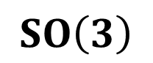

Preliminaries (2)
Skew symmetric matrix representation: [ ]
$$≔ \left[\begin{matrix}0 & {−x}_{3} & x_{2} \\ x_{3} & 0 & −x_{1} \\ −x_{2} & x_{1} & 0\end{matrix}\right]$$
$x= {(x_{1},x_{2},x_{3})}^{T}∈ ℝ^{3}$,
[
$$x$$
Given a vector
define
]
$$SO\left(3\right)$$
: the group of rotation matrices
so $\left(3\right)$
: the set of all
$$3×3$$
real skew-symmetric matrices

Slide 11
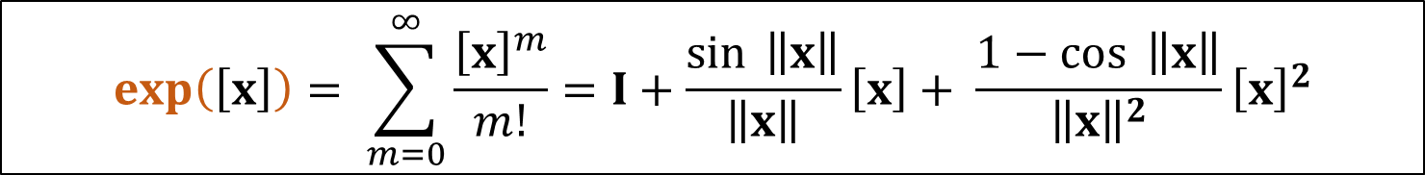
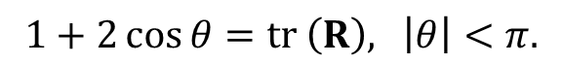

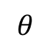
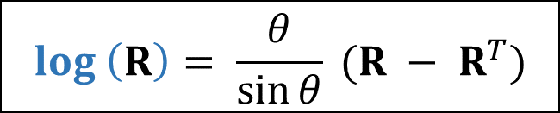

Preliminaries (3)
◆ Matrix exponential map
$$exp: so(3)→SO\left(3\right)$$
$$exp\left(\left[x\right]\right)= \sum_{m=0}^{∞}{\frac{{\left[x\right]}^{m}}{m!}}=I+\frac{\sin{ \left\|x\right\|}}{\left\|x\right\|}\left[x\right]+ \frac{1−\cos{ \left\|x\right\|}}{{\left\|x\right\|}^{2}}{\left[x\right]}^{2}$$
◆ Matrix logarithm of rotations
$log:SO\left(3\right)→$ $so(3)$
$$log \left(R\right)= \frac{θ}{\sin{θ}} (R − R^{T})$$
where
$$θ$$
satisfies
$$1+2\cos{θ=tr \left(R\right)\text{, }\left|θ\right|<π.}$$

Slide 12

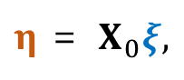

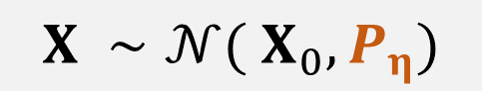
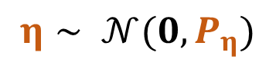
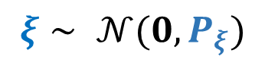
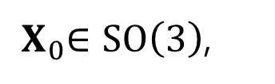
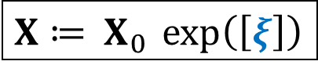
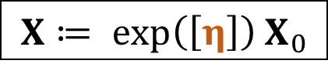
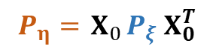
Preliminaries (4)
Random Variable
$$X$$
on
$$SO\left(3\right)$$
(1) Given
${ X}_{0}∈SO\left(3\right)$,
$$X≔ exp\left(\left[η\right]\right){ X}_{0}$$
where
$$η∼ 𝒩(0, P_{η})$$
is a Gaussian noise.
Define
$$X ∼𝒩({ X}_{0},P_{η})$$
$P_{η}$ is called “right-invariant covariance of $X$”.
(2) Alternatively, define
$X≔ { X}_{0}$ $exp\left(\left[ξ\right]\right)$
where
$$ξ∼ 𝒩(0, P_{ξ})$$
is a Gaussian noise.
$P_{ξ}$ is called “left-invariant covariance of $X$”.
Relation:
$η$ = ${ X}_{0}ξ,$
$$P_{η}={ X}_{0}P_{ξ}{ X}_{0}^{T}$$

Slide 13
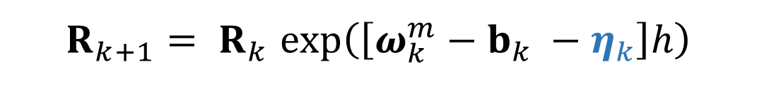
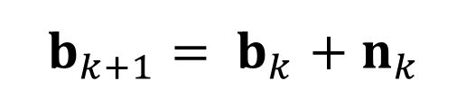
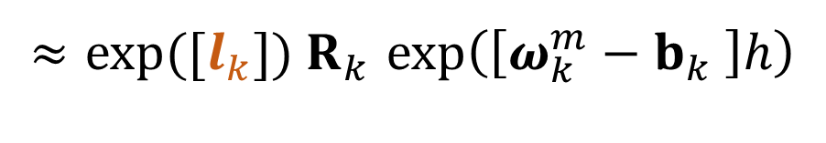
◆ State Transition Equations
$$R_{k+1}{= R}_{k}exp\left(\left[ω_{k}^{m}−b_{k} −η_{k}\right]h\right)$$
$${≈exp([l_{k}]) R}_{k}exp\left(\left[ω_{k}^{m}−b_{k} \right]h\right)$$
$$b_{k+1}{= b}_{k}+{ n}_{k}$$
where ${η_{k}, l}_{k}$, and${ n}_{k}$ are zero-mean Gaussian noises

Slide 14
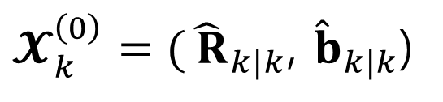
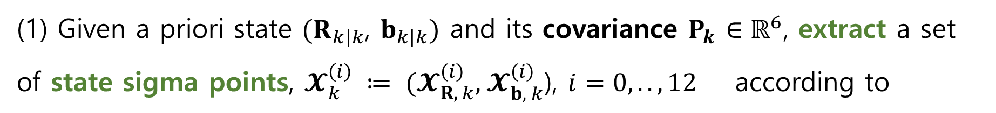
Time Update
attitude
gyro bias
(1) Given a priori state ${(R}_{k|k}$, $b_{k|k})$ and its covariance $P_{k}$ $∈ℝ^{6}$, extract a set of state sigma points, $𝓧_{k}^{\left(i\right)} ≔ (𝓧_{R, k}^{\left(i\right)}, { 𝓧}_{b, k}^{\left(i\right)}$), $i=0, .., 12$ according to
attitude
gyro bias
$𝓧_{k}^{\left(0\right)}={(\hat{ R}}_{k|k}$, ${\hat{b}}_{k|k}$)
$𝓧_{k}^{\left(i\right)}={(exp⁡([γs_{i}^{(a)}])\hat{R}}_{k|k}$, ${\hat{b}}_{k|k}+γs_{i}^{(b)}$), $i=1, ..,$6
$𝓧_{k}^{\left(i+6\right)}={(exp⁡([−γs_{i}^{(a)}])\hat{R}}_{k|k}$, ${\hat{b}}_{k|k}−γs_{i}^{(b)}$), $i=1, ..,$6

Slide 15
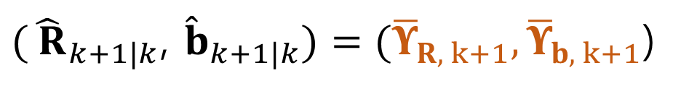
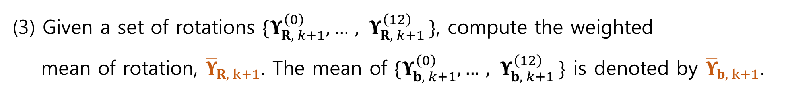
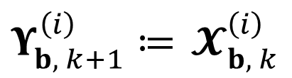
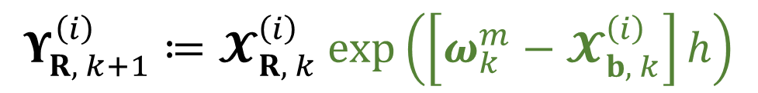
Time Update
attitude
gyro bias
(2) Define a set of sigma points ${(Υ}_{R, k+1}^{\left(i\right)},{ Υ}_{b, k+1}^{\left(i\right)})$, $i=0, .., 12$ as
$$Υ_{R, k+1}^{\left(i\right)}≔𝓧_{R, k}^{\left(i\right)} exp\left(\left[ω_{k}^{m}−{ 𝓧}_{b, k}^{\left(i\right)}\right]h\right)$$
$Υ_{b, k+1}^{\left(i\right)}≔$ $𝓧_{b, k}^{\left(i\right)}$
(3) Given a set of rotations ${\{Υ}_{R, k+1}^{\left(0\right)},{…, Υ}_{R, k+1}^{\left(12\right)}\}$, compute the weighted mean of rotation, ${\overline{Υ}}_{R, k+1}$. The mean of ${\{Υ}_{b, k+1}^{\left(0\right)},{…, Υ}_{b, k+1}^{\left(12\right)}\}$ is denoted by ${\overline{Υ}}_{b, k+1}$.
${(\hat{ R}}_{k+1|k}$, ${\hat{b}}_{k+1|k})={(\overline{Υ}}_{R, k+1},{\overline{Υ}}_{b, k+1}$)

Slide 16
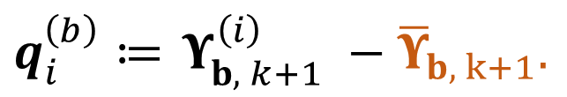
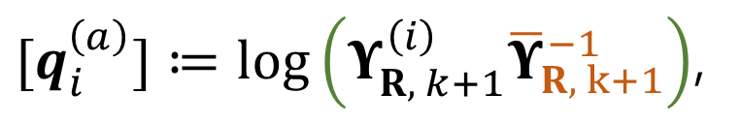
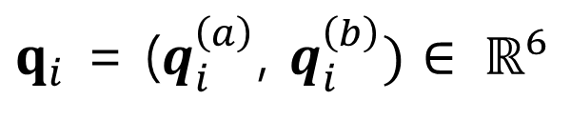
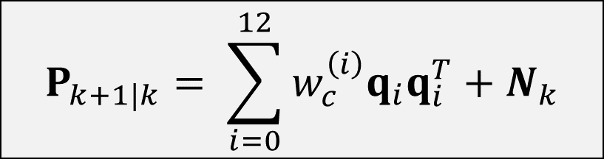
Time Update
$[q_{i}^{\left(a\right)}]≔log\left(Υ_{R, k+1}^{\left(i\right)}{\overline{Υ}}_{R, k+1}^{−1}\right)$,
$q_{i}^{\left(b\right)}≔$ $Υ_{b, k+1}^{\left(i\right)} −{\overline{Υ}}_{b, k+1}.$
(4) Define
$$P_{k+1|k}= \sum_{i=0}^{12}{w_{c}^{\left(i\right)}q_{i}q_{i}^{T}+N_{k}}$$
where
$q_{i}$ = ($q_{i}^{\left(a\right)}$, $q_{i}^{\left(b\right)})∈ ℝ^{6}$
Process noise covariance

Slide 17
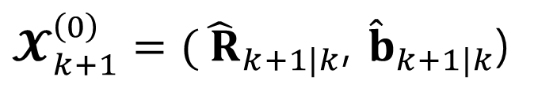
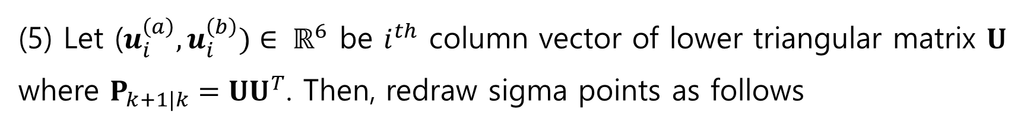
Time Update
(5) Let ($u_{i}^{\left(a\right)},u_{i}^{\left(b\right)})∈ ℝ^{6}$ be $i^{th}$ column vector of lower triangular matrix $U$ where $P_{k+1|k}=UU^{T}$. Then, redraw sigma points as follows
$𝓧_{k+1}^{\left(0\right)}={(\hat{ R}}_{k+1|k}$, ${\hat{b}}_{k+1|k}$)
$𝓧_{k+1}^{\left(i\right)}={(exp⁡([γu_{i}^{(a)}])\hat{R}}_{k+1|k}$, ${\hat{b}}_{k+1|k}+γu_{i}^{(b)}$), $i=1, ..,$6
$𝓧_{k+1}^{\left(i+6\right)}={(exp⁡([−γu_{i}^{(a)}])\hat{R}}_{k+1|k}$, ${\hat{b}}_{k+1|k}−γu_{i}^{(b)}$), $i=1, ..,$6

Slide 18
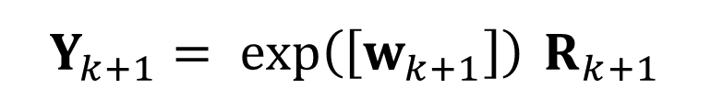
◆ Measurement Equation
$Y_{k+1}= exp\left(\left[w_{k+1}\right]\right)$ $R_{k+1}$
a zero-mean Gaussian noise
Solution to Wahba’s problem using a pair of measurements of gravity and the earth’s magnetic field
If “large acceleration or magnetic disturbance” is detected, then the measurement reconstruction with a vector selector (or adaptation of noise covariance) can be used.

Slide 19
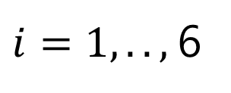
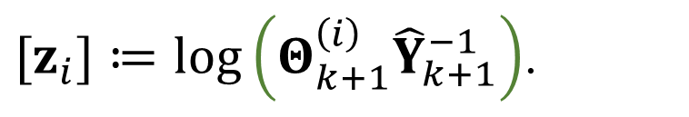
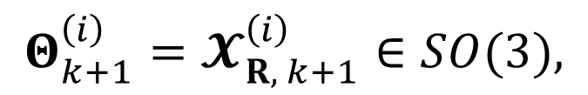
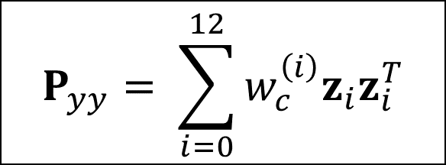
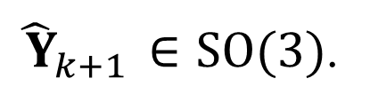
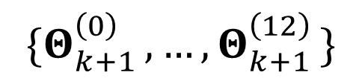
Measurement Update
(1) Define the measurement sigma points
$$Θ_{k+1}^{\left(i\right)}=𝓧_{R, k+1}^{\left(i\right)}∈SO(3),$$
$i=1, ..,$6
then, the mean of
$${\{Θ}_{k+1 }^{\left(0\right)},…,Θ_{k+1 }^{\left(12\right)}\}$$
is denoted by
${\hat{ Y}}_{k+1}$ $∈SO(3)$.
$$P_{yy}= \sum_{i=0}^{12}{w_{c}^{\left(i\right)}z_{i}z_{i}^{T}}$$
where
${[z}_{i}]≔log\left(Θ_{k+1}^{\left(i\right)}{\hat{Y}}_{k+1}^{−1}\right)$.

Slide 20
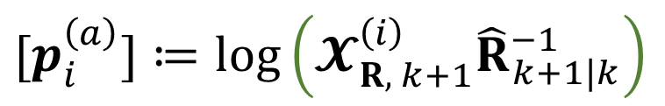
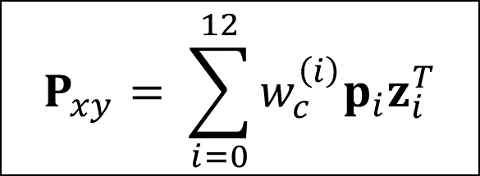
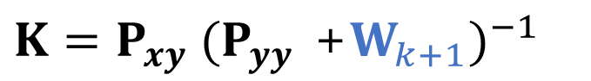
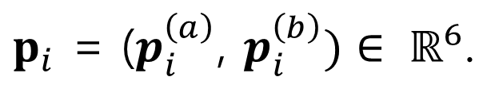
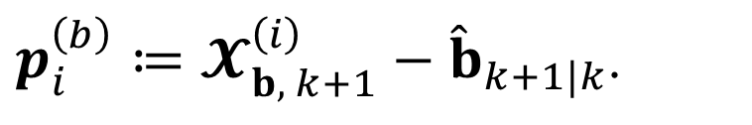
Measurement Update
(4) Define
$[p_{i}^{\left(a\right)}]≔log\left(𝓧_{R, k+1}^{\left(i\right)}{\hat{R}}_{k+1|k}^{−1}\right)$
and
$p_{i}^{\left(b\right)}≔𝓧_{b, k+1}^{\left(i\right)}−{\hat{b}}_{k+1|k}$.
Then,
$$P_{xy}= \sum_{i=0}^{12}{w_{c}^{\left(i\right)}p_{i}z_{i}^{T}}$$
where
$p_{i}$ = ($p_{i}^{\left(a\right)}$, $p_{i}^{\left(b\right)})∈ ℝ^{6}$.
(3) Kalman gain is given by
$K=P_{xy} {(P_{yy} \text{+}W_{k+1})}^{−1}$
Proposed covariance of the solution to Wabha’s problem :
more accurate and efficient than Schuster’s covariance

Slide 21








Measurement Noise Covariance
${(\sum_{i=1}^{2}{\frac{1}{σ_{i}^{2}}} (I − r_{i}r_{i}^{T}))}^{−1}$
$r_{1}$ = ${\text{(0, 1, 0)}}^{T}$, ${ r}_{2}$ = ${\text{(0, }\text{cos} φ\text{, }\text{sin} φ\text{)}}^{T}$
Let the measurements of calibrated accelerometers and magnetometers be
$v_{1}, v_{2}∈ℝ^{3}$, respectively.
$φ ≈\cos^{−1}{({\hat{v}}_{1}^{T}{\hat{v}}_{2})}$
where
${\hat{v}}_{i}≔E\left(v_{i}\right)$,
$$i=1, 2$$
$σ_{i}^{2}=\frac{tr (M_{a}^{(i)})}{2}$
where
$$M_{a}^{(i)}= \frac{1}{N}\sum_{j=1}^{N}{(v_{i}^{\left(j\right)}−{\hat{v}}_{i}){(v_{i}^{\left(j\right)}−{\hat{v}}_{i})}^{T}}$$

Slide 22






Measurement Update
(2) Define
$[δ]≔log\left(Y_{k+1}{\hat{Y}}_{k+1}^{−1}\right)$
and
$φ={(φ}^{(a)},φ^{(b)})≔ Kδ∈ ℝ^{6}$.
Then,
the state and covariance are updated by
$${\hat{ X}}_{k+1|k+1}={(exp⁡([φ^{(a)}])\hat{R}}_{k+1|k}\text{, }{\hat{b}}_{k+1|k}+φ^{(b)}\text{),}$$
$P_{k+1|k+1}=M(φ^{\left(a\right)})$($P_{k+1|k}−KP_{yy}K^{T}){M(φ^{\left(a\right)})}^{T}$
where
$$M\left(φ^{\left(a\right)}\right)= \left[\begin{matrix}J_{l}(φ^{(a)}) & 0 \\ 0 & I\end{matrix}\right]$$
Left Jacobian of $SO\left(3\right) at φ^{(a)}$
$$J_{l}\left(y\right)=I+\left(\frac{1 − \cos\left\|y\right\|}{{\left\|y\right\|}^{2}}\right)\left[y\right]+\left(\frac{\left\|y\right\|−\sin\left\|y\right\|}{{\left\|y\right\|}^{3}}\right){\left[y\right]}^{2}$$
$$y∈ℝ^{3}$$

Slide 23
Simulation Results
attitude estimation error
Gyro bias estimation error

Slide 24
Simulation Results
500 trials

Slide 25
Results of Real Experiments
10 trials
attitude estimation error
Gyro bias estimation error

Slide 26
Computation Times
Averaged over 3000 steps
 | UKF on SO(3) | UKF on quaternion | EKF on quaternion | NCF on SO(3)
Average time (micro-seconds) | 8.1 | 7.9 | 6.8 | 0.2
Implemented in C++
executed on a desktop computer with Intel i5-4670 CPU (3.4 GHz)

Slide 27

Demo (1): Implementation of proposed algorithm

Slide 28



Demo (2): IMU on a UAV
Left teapot: IR markers
infrared camera (Optitrack Inc.)
Right teapot: IMU (using proposed method)

Slide 29

Demo: Motion Capture using our algorithm

Slide 30
Thank you

